Slide 1


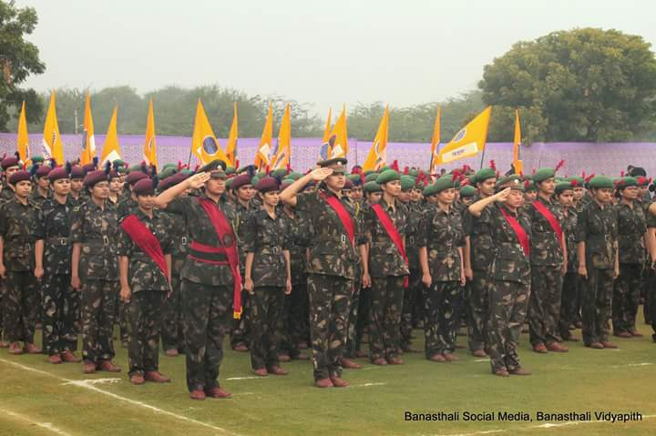
Apaji Institute Of Mathematics And Applied Computer Technologies
Banasthali Vidyapith
Submitted By:
Anukriti Trivedi
Priya Kulshrestha
Shilpi Saxena
Sonam Sharma
Guided By:
Mrs. Sudha Morwal

Slide 2
Table Of Content
Introduction
Scope
Software Requirement
Hardware Requirement
Technology used
Actors
Use cases of Actors
Data Flow Diagram(DFD)
Entity Relationship Diagram(ERD)
Database description
Screen Images
References

Slide 3
Introduction
“Banasthali Notification Zone ”will reinforce and maintain details about : –
Communication held between faculty members and students.
Communication held between student committee and students.
This web application will be designed for Banasthali members in order to provide them facility of notifying students about campus ongoings and solving their related queries.

Slide 4
Scope
“Banasthali Notification Zone” is a Web Application which intends to connect students, student committee and faculty of Banasthali
In constructing connection beyond the boundaries of classroom between the users.
In maintaining an online schedule.
Users can update themselves with the recent and important information.
The scope of the project can be listed as under:-
Handouts Updations
Notes Availability
E-books
Schedule Updations
Assignments
Extra student activities
Query related to above

Slide 5
Software Requirements
Server Side:
OS: Windows Server 2007 or onwards
Web Server: IIS 5.0 or onwards with ASP.Net framework
Client Side:
OS: Any OS
Browser: Any browser supporting javascript , css , xml.

Slide 6
Hardware Requirements
Server Side:
RAM: 1 GB or more
HDD: 20GB or more (Free space excluding data size)
Processor: 1-2 GHz (P4) or onwards
Client Side:
RAM: 512 MB
HDD: 10 GB or more (Free space excluding data size)
Processor: 450GHz (P1)

Slide 7
Technology Used
Front End: ASP.Net with C#
Back End: SQL Server 2008
Design Tool: Microsoft Visual Studio 2010
Web Server: IIS 5.0 with ASP.NET run time

Slide 8
Actors
Admin
Faculty
Students

Slide 9
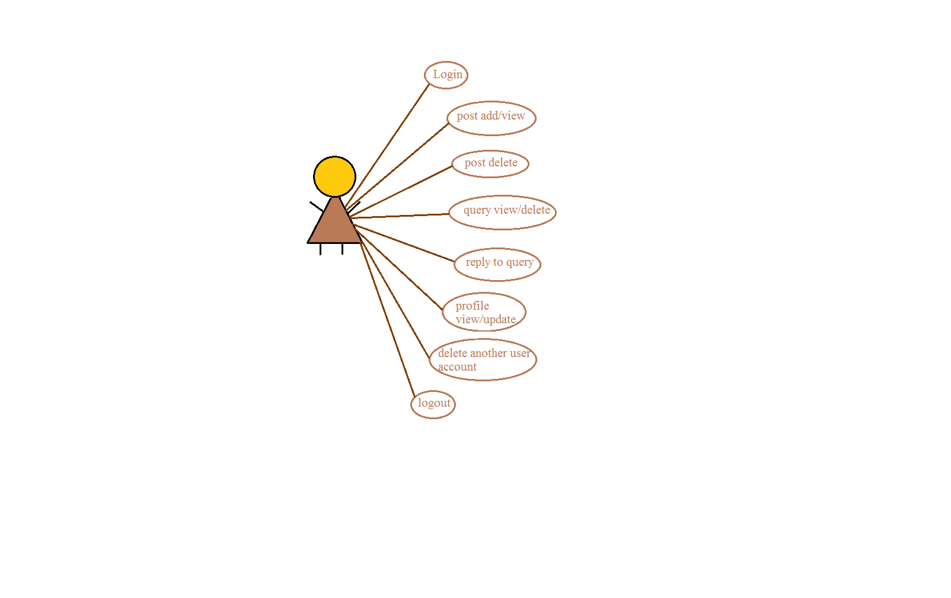
Use cases of Actors
Admin
Admin

Slide 10
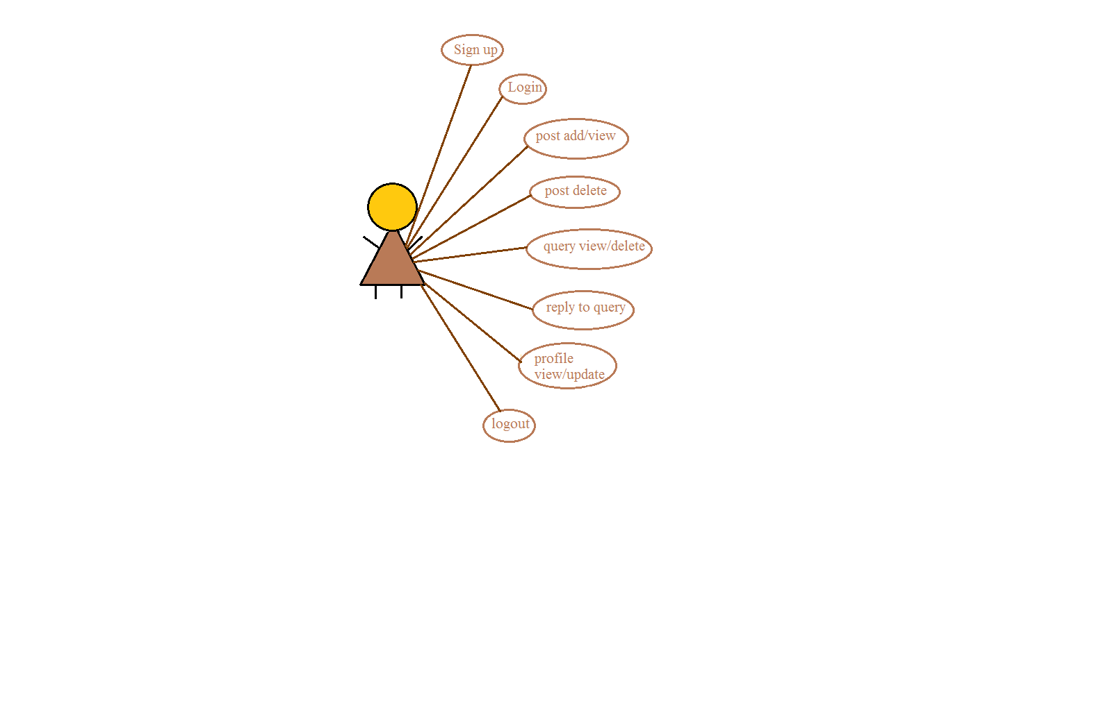
Faculty
Faculty

Slide 11

Student

Slide 12
Use Case No | 1
Use Case Name | Sign Up
Actors: | Students and faculty.
Descriptions | This module helps the faculty and students to create new accounts .
Input | Name, smart card ID , course , password , department , semester.
Normal Course Events | Users enter their smart card id. Users enter their passwords. User enters other required Information. Users click submit button. System connects to database. A message appears which shows the Account created applied.
Alternative Courses | Same smart card id exists in database Error message appears. Continue with step 1 in the normal course Events. 4. An error may occur during the database Operation.
Output | New user account will be created.

Slide 13
Use Case No | 2
Use Case Name | Login
Actors: | Students, Admin and Faculty.
Descriptions | This module helps the admin, faculty and student to login.
Pre-conditions | The user must be a member of the system.
Input | Smart Card Id and password.
Normal Course Events | Users enter their smart card id. Users enter their password. Users click login button. System connects to database. Homepage displayed.
Alternative Courses | User enters incorrect id and/or password. 2.Error message appears. 3.Continue with step 1 in the normal course events. 4.An error may occur during Db operation .`System shows error messages.
Output | User homepage will be displayed.

Slide 14
Use Case No. | 3
Use Case Name | Logout
Actors: | Students, Admin and Faculty.
Descriptions | This module helps the administrator, faculty and student to logout.
Pre-conditions | The user must be logged in to the website.
Normal Course Events | Users click to Logout button. DB connection terminated. The website users Logout successfully. The website will be directed to Login page.
Alternative Courses | In case, user accidentally closes the tab then the user will be automatically logout from her/his account but it is recommended to Logout from the account using “Logout” option for security purposes.
Output | Website login page will be displayed.

Slide 15
Use Case No | 4
Use Case Name | Profile Updation
Actors: | Students, Admin and Faculty.
Descriptions | This module helps the faculty , admin and student to update the information about themselves.
Pre-conditions | The user must be logged on to the system.
Input | Information to be modified.
Normal Course Events | The user must be logged on to the system which is defined in use case 2. 2. User may go to profile view option. 3. The system retrieves user information from DB and shows the information on new page. 4. The user can update his/her profile in desired information field. 5. The user clicks on Update Button. 6. The user profile is updated.
Alternative Courses | The system cannot access the DB. The system redirects to the homepage. The system puts a message on the top of the window about the problem. Continue with step 2 in the normal course events.
Output | User Profile Information will be updated.

Slide 16
Use Case No | 5
Use Case Name | Ask query
Actors: | Students and Faculty
Descriptions | This module helps the student to ask query to their faculty .
Pre-conditions | The user must be logged on to the system.
Input | Query to be asked
Normal Course Events | The student must select the post for which they want to query. 2. The user clicks the Query option. 3. The user types the text in the box provided. 4. The user clicks the Submit Button. 5. The query will be posted.
Alternative Courses | The user should enter the query within the character limit. 2. The user clicks the Submit Button without entering any query in the textbox provided. 3. Error message appears. 4. Continue with step 3 in the normal course events.
Output | query will be add on the post.

Slide 17
Use Case No | 6
Use Case Name | Add and delete posts.
Actors | Admin , Student and Faculty
Descriptions | This module helps the admin , student and faculty to add or delete the posts.
Pre-conditions | The Administrator , student and faculty should have appropriate rights to add and delete post.
Input | Information about the notices.
Normal Course Events | The user click on POST Link 2.The user enters the information about notices in the textbox provided and image/files if needed in image box. 3. The user clicks the Submit Button. 4. The notices will be posted with the entered information. 5. If any unappropriate post have been posted by the user, then the facility to delete the post can be achieved by Delete Button.
Alternative Courses | If the user clicks on Submit button without any information in notice textbox or in select any file then an error message will appear.
Output | Notice will be added or deleted.

Slide 18
DATA FLOW DIAGRAMS

Slide 19
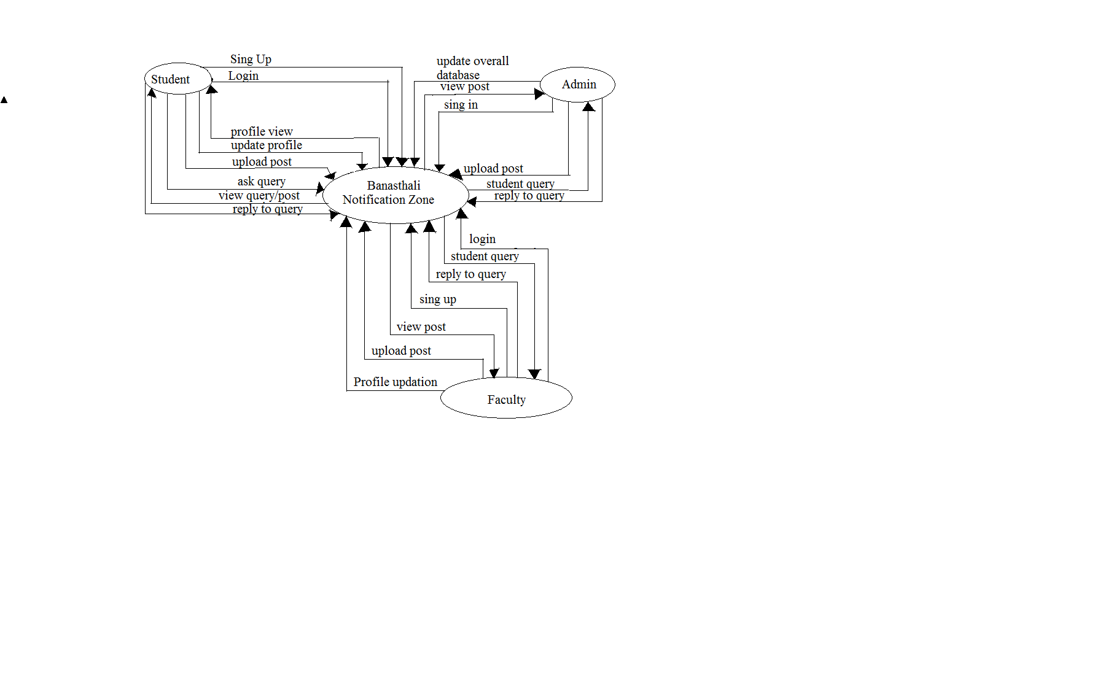
0-Level DFD

Slide 20
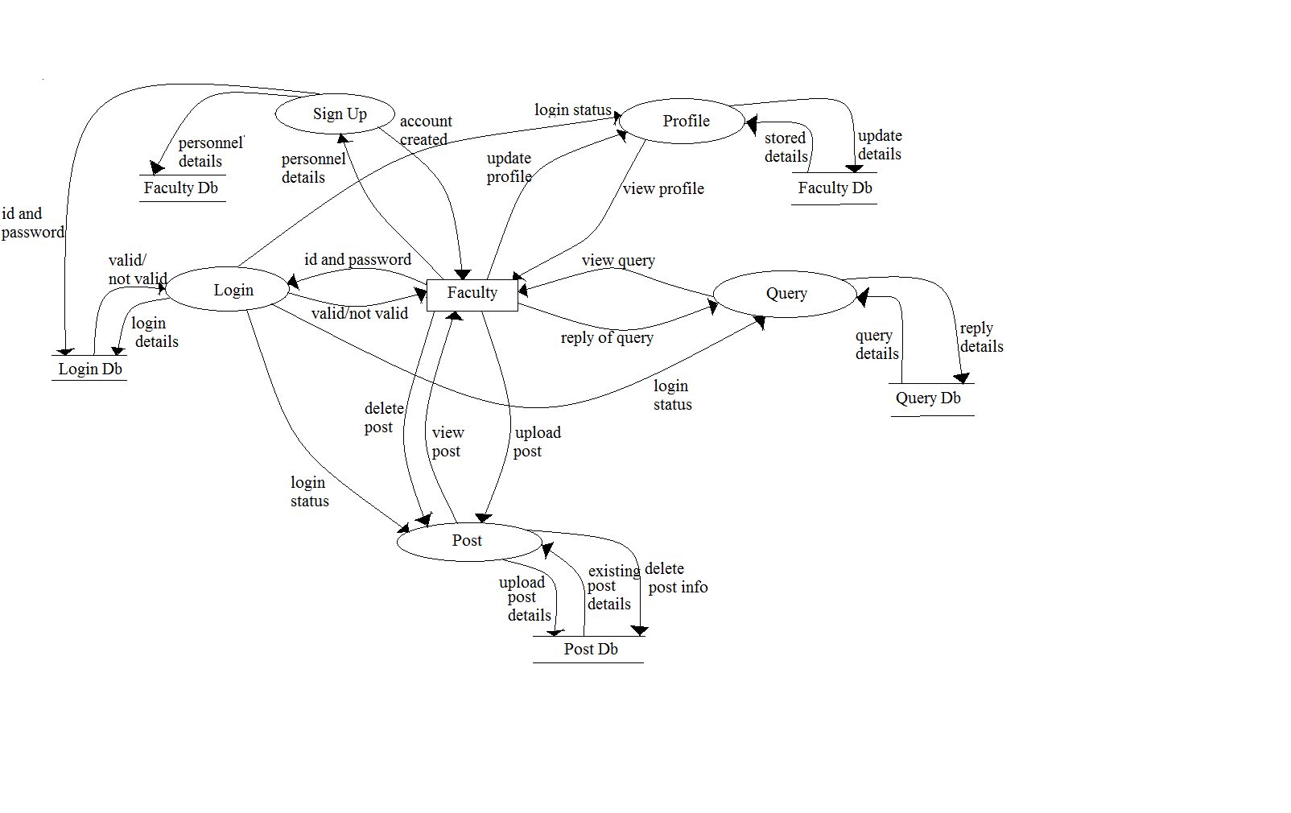
1-Level DFD for Faculty

Slide 21
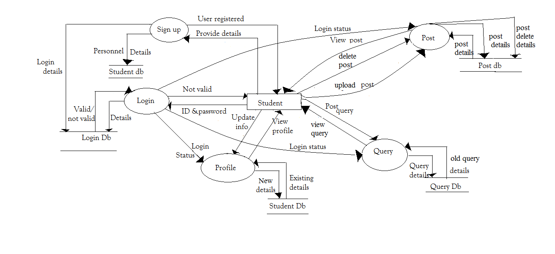
1-Level DFD Student

Slide 22
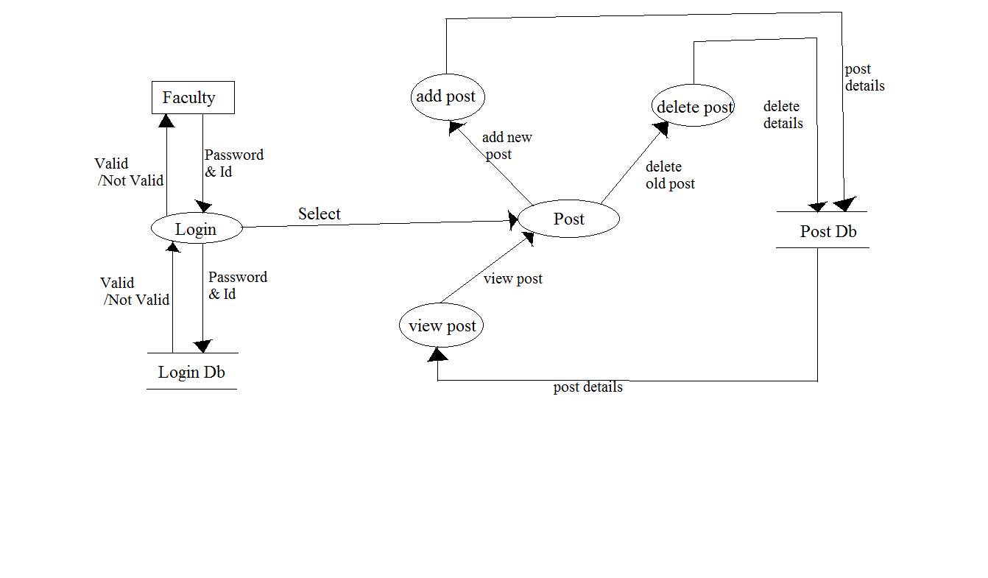
2-Level DFD for Faculty Post

Slide 23
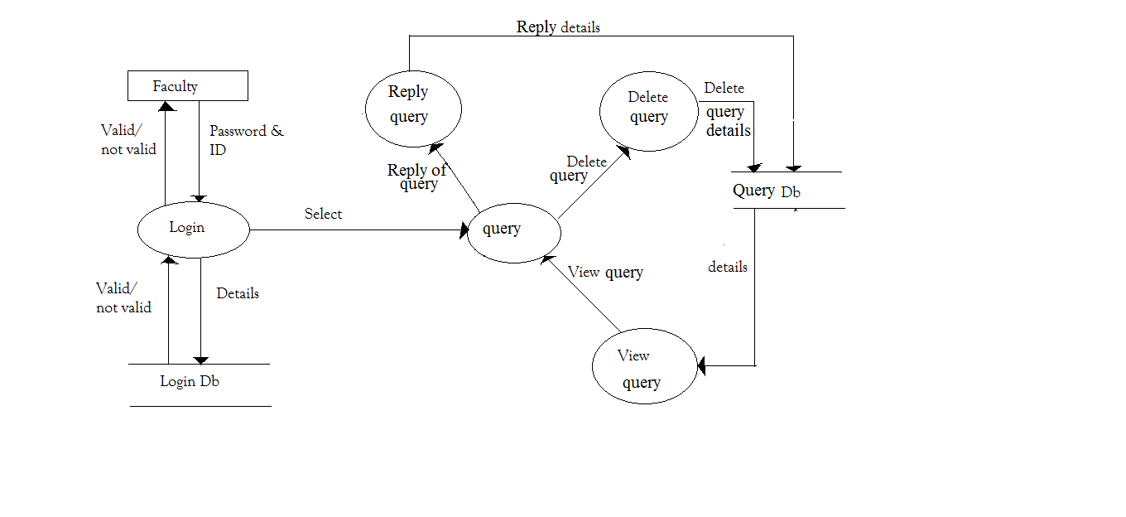
2-Level DFD for Faculty Query

Slide 24
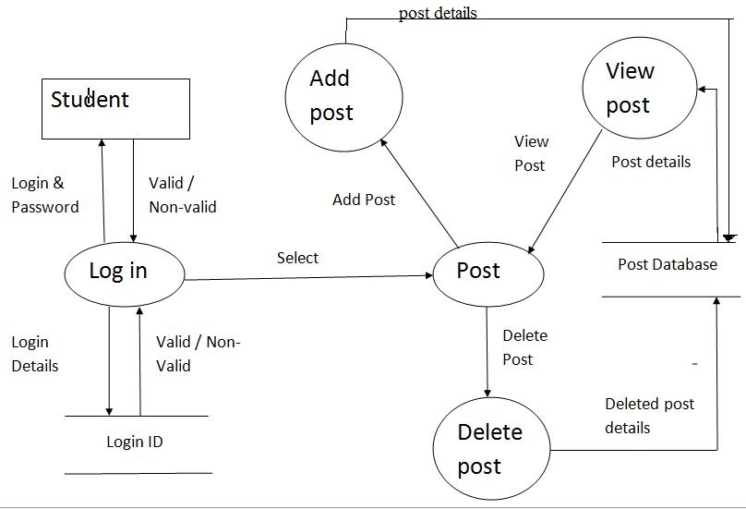
2-Level DFD for Student Post

Slide 25
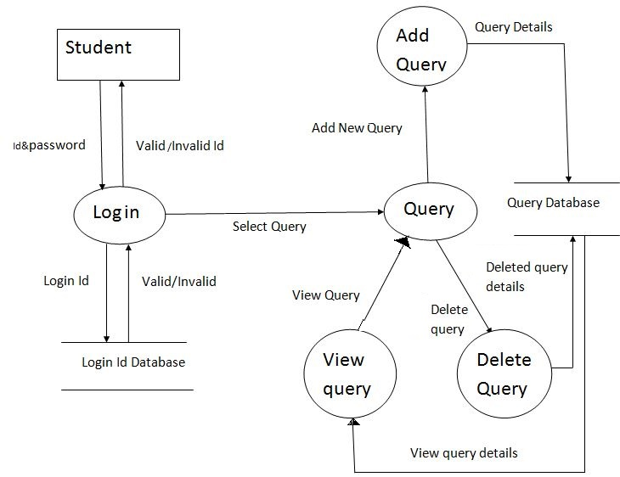
2-Level DFD for Student Query

Slide 26
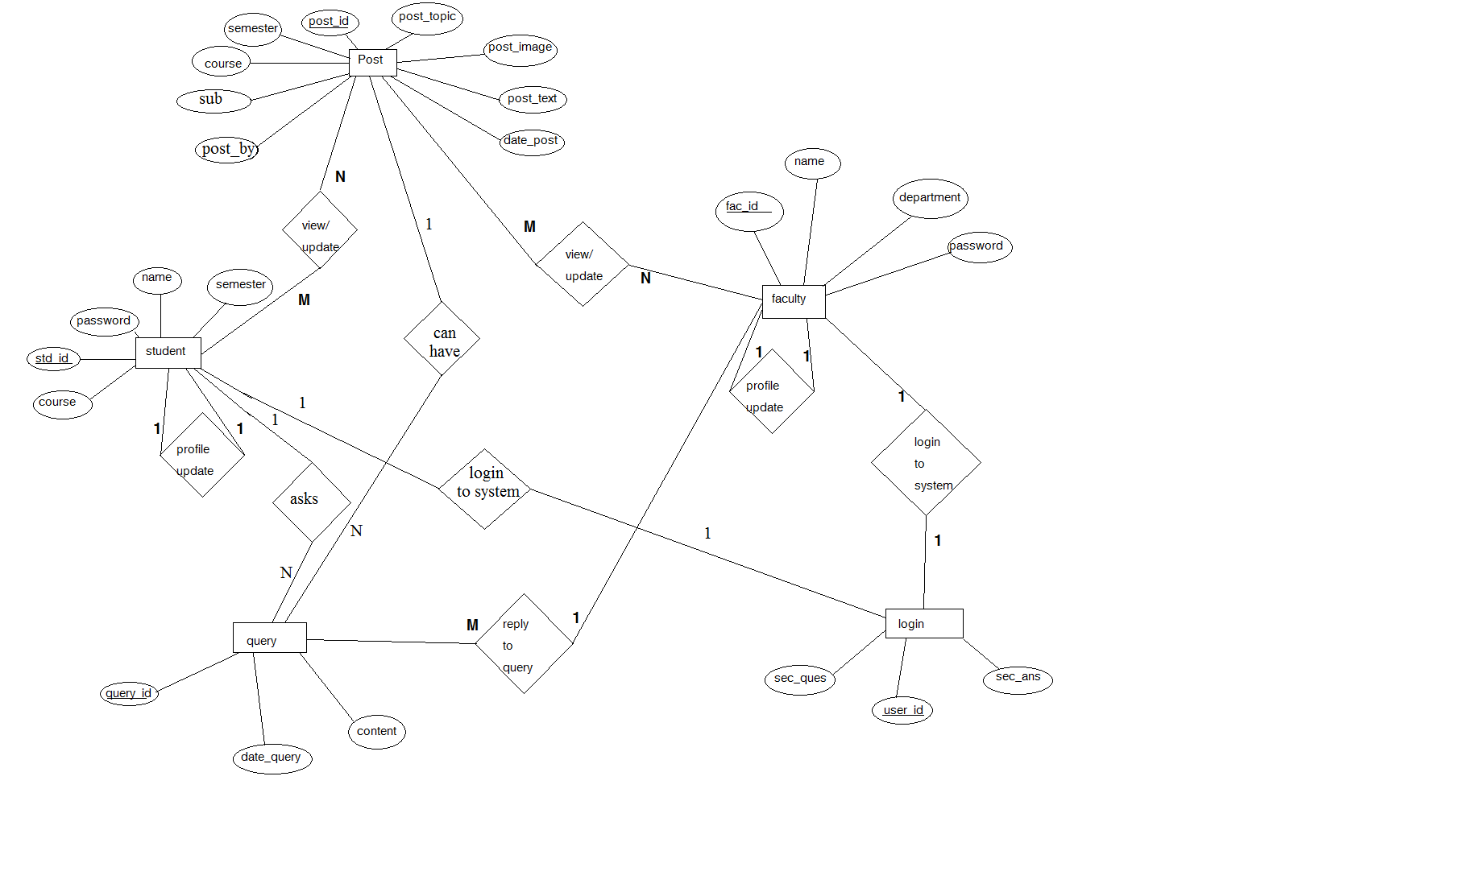
ER- Diagram

Slide 27
Data Design
Database Description

Slide 28
Login Table
Field | Type | Constraints | Description
Smart_card_id | Varchar (10) | Primary key | Smart card id of the user
password | Varchar (8) | Not null | Password of user

Slide 29
Student Table
Field | Type | Constraints | Description
Smart_card_id | Varchar(10) | Primary key | Smart card id of the Student
name | Varchar(20) | Not Null | name of the Student
Course | Varchar(8) | Not Null | Course of the Student
sem | Numeric(02) | Not Null | Semester of students
password | Varchar(8) | Not null | Password of student account

Slide 30
Faculty Table
Field | Type | Constraints | Description
Smart_card_id | Varchar(10) | Primary key | Smart card id of the Faculty
Name | Varchar(20) | Not Null | name of the Faculty
Dept | Varchar(10) | Not Null | Department
password | Varchar(8) | Not Null | Password of the faculty’s account

Slide 31
Post Table
Field | Type | Constraints | Description
post_id | Numeric(10) | Primary key | Id of the post
post_topic | Varchar(50) | Not Null | Topic of the post
post_text | Varchar(MAX) | Null | Detail of the post
Post_uploads | Varchar(50) | Null | File uploads(pdf, images)
Date_time | DateTime | Not Null | Date & time of post
Login_id | Varchar(10) | Foreign key | Smart card id of the logged in user
Course | Varchar(8) | Not Null | Post Corse
Sub | Varchar(20) | Not Null | Subject of post

Slide 32
Query Table
Field | Type | Constraints | Description
Query_id | Numeric(20) | Primary key | query id
Login_id | Varchar(20) | Foreign Key | Smart card id of the logged in user
Content | Varchar(MAX) | Not null | Query content
Date_time | DateTime | Not Null | Date and time of query

Slide 33
Admin Table
Field | Type | Constraints | Description
Smart_card_id | Varchar(20) | Primary key | Smart card id of the Admin
Password | Varchar(8) | Not null | Password of Admin
Sec_ques | Varchar(50) | Not null | Security Question
Sec_ans | Varchar(50) | Not Null | Security answer

Slide 34
Screen Images

Slide 35
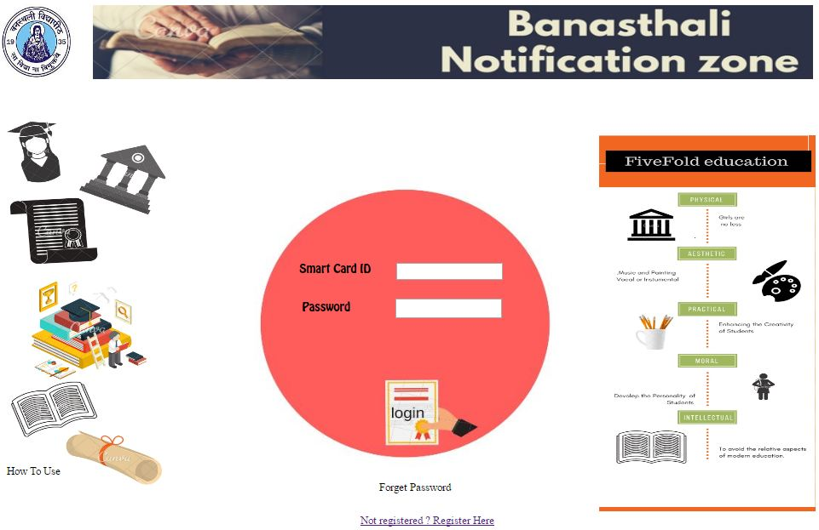
Login Page

Slide 36
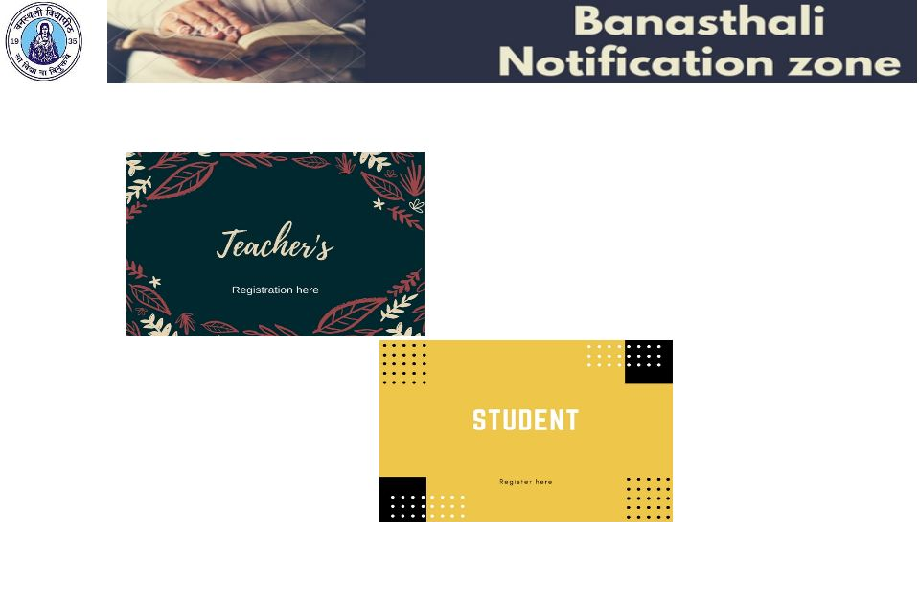
New Registeration’s Selection

Slide 37
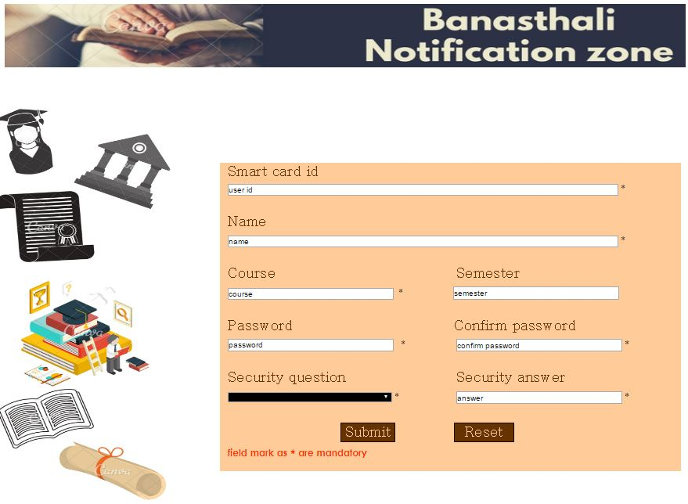
Sign up Page for Student

Slide 38
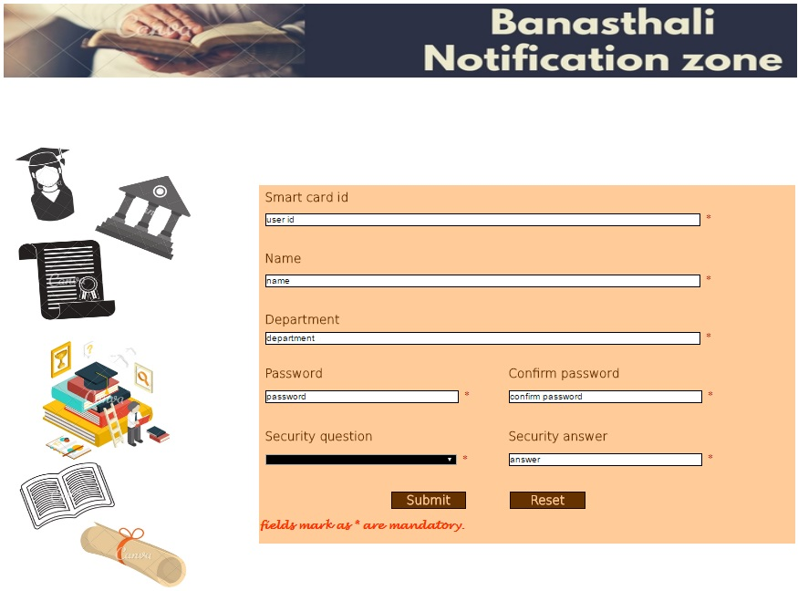
Sign up Page for Faculty

Slide 39
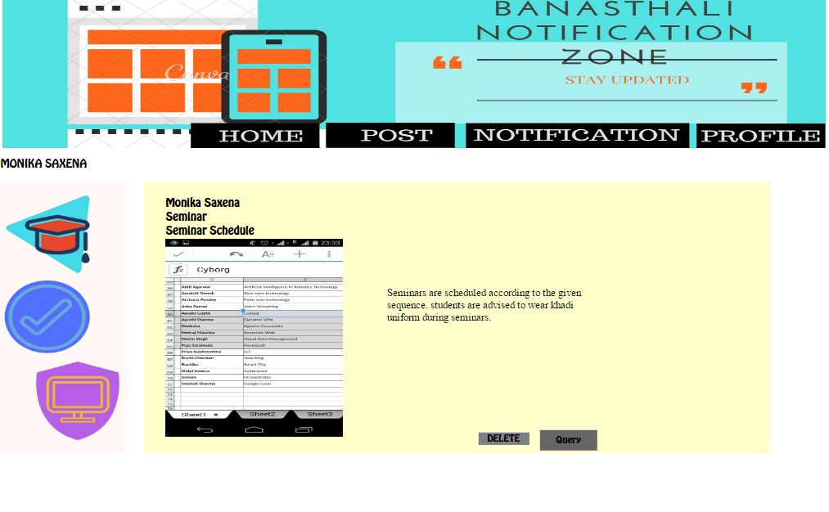
Home Page for Student & Teacher

Slide 40
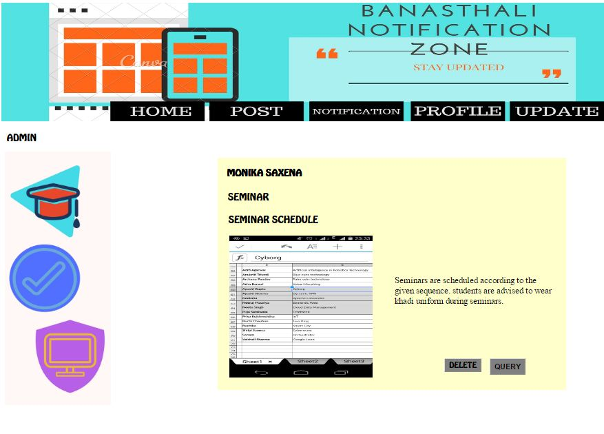
Home Page for Admin

Slide 41
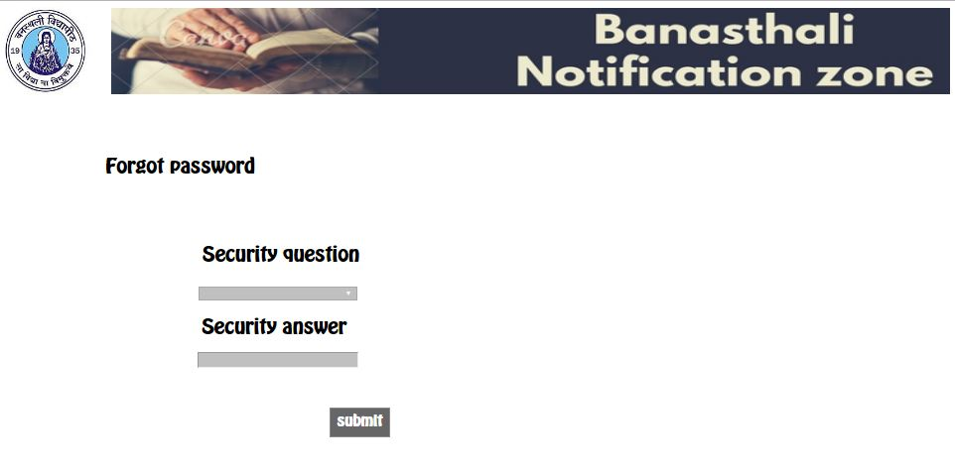
Forget Password

Slide 42
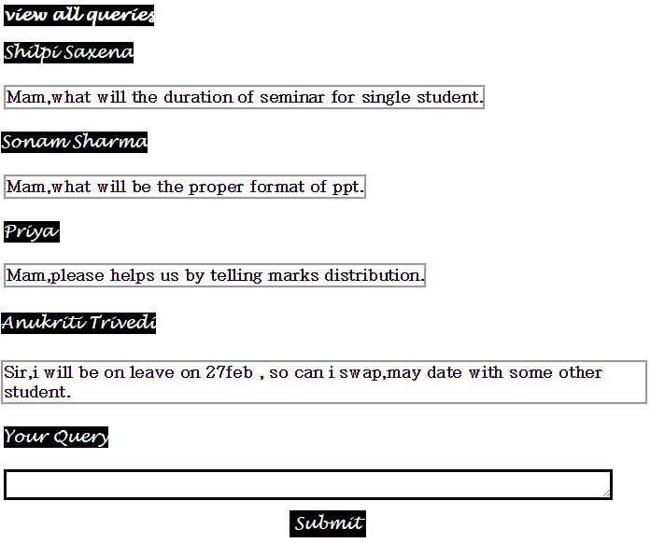
Query View

Slide 43
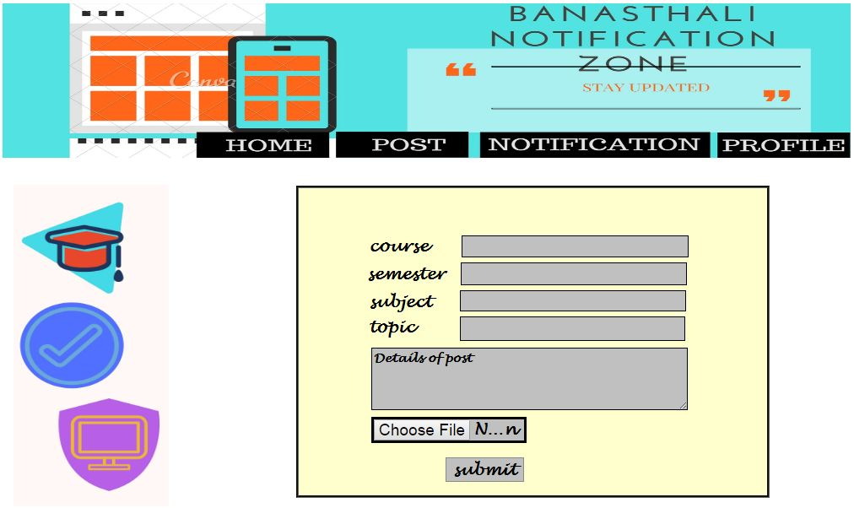
New Post

Slide 44
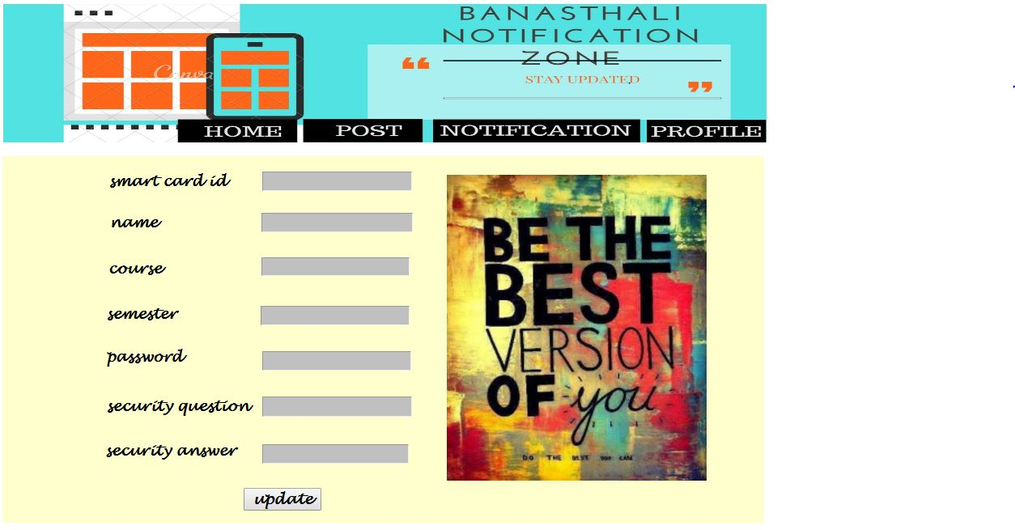
Profile View of Student

Slide 45
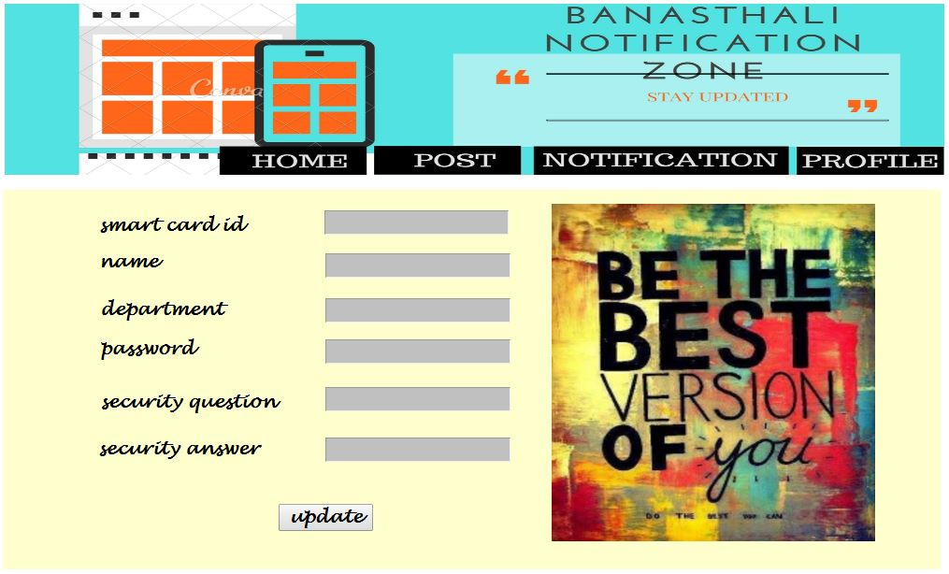
Profile View of Teacher

Slide 46
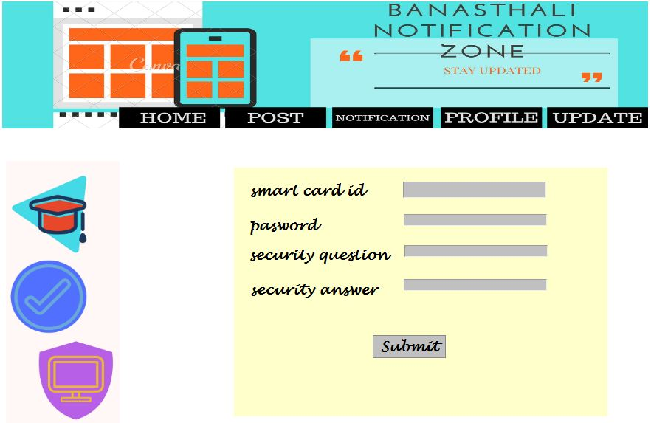
Profile View of Admin

Slide 47
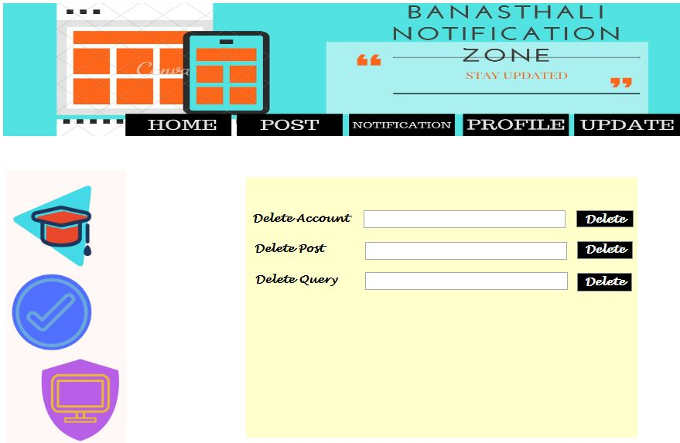
Update option for Admin

Slide 48
References
Pressman Roger S., Software Engineering “A Practitioner’s Approach”
Fifth Edition, McGraw-Hill Publication, 2000.
Navathe Shamkant B., Fundamentals of Database Systems,
Fifth Edition, Pearson Publication.
Evjen Bill, Hanselman Scott, Rader Devin,
Professional ASP.Net 3.5 in C# and VB,
Sp1Edition, Wrox Publication, 2009.
Evjen Bill, Professional C#,
Wrox Publication, 2008.
Bayross Ivan, SQL, PL/SQL,
Third Edition, BPB Publication.
Schildt Herbert, The Complete Reference C# 3.0
Third Edition, Tata McGraw-Hill.
IEEE STD 830-1998, IEEE Recommended Practice for Software Requirement Specifications and Software Design Specifications.

Slide 49
ThankYou

